Slide 1

CSE- 321
Software Engineering
Lecture : 05 Software Processes (cont.)
Fahad Ahmed
Lecturer, Dept. of CSE
E-mail: fahadahmed@uap-bd.edu

Slide 2
Lecture Outlines
Waterfall Model

Slide 3
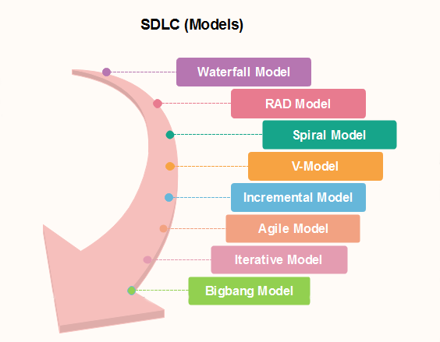
Popular SDLC models

Slide 4
Waterfall Model
What is The Waterfall Model? (Iterative)
Also called classic software life cycle or sequential model or linear-sequential life cycle model
Process activities (phases/stages) are clearly separated
After a number of iterations, phases of the life cycle (such as specification and design) are “frozen”
It was introduced in 1970 by Winston Royce.

Slide 5
Waterfall Model
When to use SDLC Waterfall Model
Waterfall model can be used when
Requirements are not changing frequently
Can be used also for parts of larger software systems
Requirement is clear
Environment is stable
Technology and tools used are not dynamic and is stable
Resources are available and trained
Drawback of the waterfall model
Difficult to incorporate change requests.
Incremental delivery not supported.
Overlapping of phases not supported.
Risk handling not supported.
Limited customer interactions.

Slide 6

Thanks to All

